Slide 1
Module-01: C Programming Basics
Part-1: Basic C Program and GCC
CS 1714 – Computer Programming II

Slide 2

About C
This presentation assumes that you already have the foundational programming knowledge and skills from CS 1083 or other CS1 course. It is important for your success in this course to have mastered these foundational programming topics.
In this presentation, we will highlight the most important parts of getting started with C programming and its key differences from languages like Java.

Slide 3
About C
The C programming language was created by Dennis Ritchie in 1972 at the Bell Laboratories.
C is a mid-level language. We can work on the high-level as well as the low-level: we can embed assembly code into our programs.
C is the foundation for other languages, such as C++ and Java, which accounts for the similar syntax.
C is portable – it can be compiled anywhere that has a C compiler.
C is widely used for systems and applications development, especially when working with hardware.
C allows for more control in terms of memory management.
C is free and widely-supported.

Slide 4
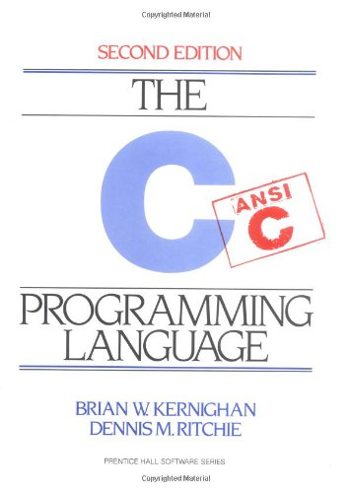
ANSI C
There are several versions of C with C18 (the revision of C in year 2018) being the latest version. The last major revisions were C11 in 2011 and C99 in 1999.
Whenever possible, the example code presented in this course will adhere to ANSI C also known as Standard C, which is the predecessor of all these newer versions.
Since you may not know what C compiler you are working with in later life, it is important to know ANSI C as all later versions support this standard.

Slide 5
Basic C Program
This is the basic C program you should always start with. We will examine each line in the next slides.
#include<stdio.h>
int main(int argc, char* argv[])
{
printf("This is my first C program\n");
return 0;
}
This program can be saved with any file name so long as it has a .c file extension.

Slide 6
Basic C Program
The first line is a preprocessor directive, which starts with a #, to include a header file called stdio.h.
This #include statement says, before we compile, bring in the functions from stdio.h (standard input and output): a file that gives us access to all the basic input and output functions.
#include<stdio.h>
int main(int argc, char* argv[])
{
printf("This is my first C program\n");
return 0;
}
Preprocessor directives are noted by the hash mark or pound sign in front of the keyword.

Slide 7
Basic C Program
The next line is the main() function.
The main() is the entry point to our program when we execute it.
The return type for main() in C is int.
We typically return 0 when the program ends normally.
#include<stdio.h>
int main(int argc, char* argv[])
{
printf("This is my first C program\n");
return 0;
}

Slide 8
Basic C Program
The main() has two parameters, int argc and char* argv[].
You may see other code examples where the parameters might be void or there might be no parameters at all.
For now, just include them.
#include<stdio.h>
int main(int argc, char* argv[])
{
printf("This is my first C program\n");
return 0;
}
We will eventually use the argc and argv parameters, so it would be a good habit to use them consistently.

Slide 9
Basic C Program
We use printf() for standard output. This function prints out formatted text.
It works like the printf() used in Java.
In this example, we are printing a string with a message.
#include<stdio.h>
int main(int argc, char* argv[])
{
printf("This is my first C program\n");
return 0;
}
Save this program with any file name and a .c file extension. For e.g. firstProgram.c

Slide 10

About gcc
gcc is the GNU Compiler Collection and is the standard compiler found in Linux/UNIX.
After we write our C program in vim, we will run gcc on our source code to compile and build our executable. Unlike an IDE, we have two separate tools for writing our source code and compiling.
Benefits of gcc include:
Free and open source
Supports multiple languages (e.g., C, C++, Objective C, etc.)
Helps us better understand the compilation process

Slide 11
Four Stages of Compilation
Preprocessor
Compilation
Assembly
Linking
Resolve all preprocessor directives (anything with a #)
Convert the code into machine dependent assembly code
Convert the assembly code to object code (binary format) for a specific processor
Combine object code in the correct order, bring in libraries, and creates the executable file
This is just a high-level description of the compilation process, but we will later take a deeper dive into what each gcc stage really does.

Slide 12
C Compiler
When compiling a C program, the compiler will generate the assembly code for the machine that you are on.
If you want to make sure that your program works on another machine, you need to compile it there. In that sense, C is portable and machine independent.

Slide 13
Using gcc
To use gcc, you need to be in your Linux account and in the directory where your source code is. Then, on the command line, you type:
If you have more than one source file (any file that has the .c extension), you list them all out.
gcc nameoffile.c

Slide 14
Executing the Program
If your code successfully compiles, it will create an executable. The default name for our executable is a.out. To execute your program, we type:
If your code does not successfully compile, maybe due to syntax errors, all the errors will be listed out. You will need to fix them before you re-compile.
If there is an existing a.out and we re-compile, it will overwrite the existing output file.
./a.out

Slide 15
Using gcc with Optional Executable Name
If we want to name our executable something more specific, other than the a.out, we can include the option -o followed by the name we want for an executable.
To execute, we type:
gcc nameoffile.c –o executablename
./executablename

